Slide 1
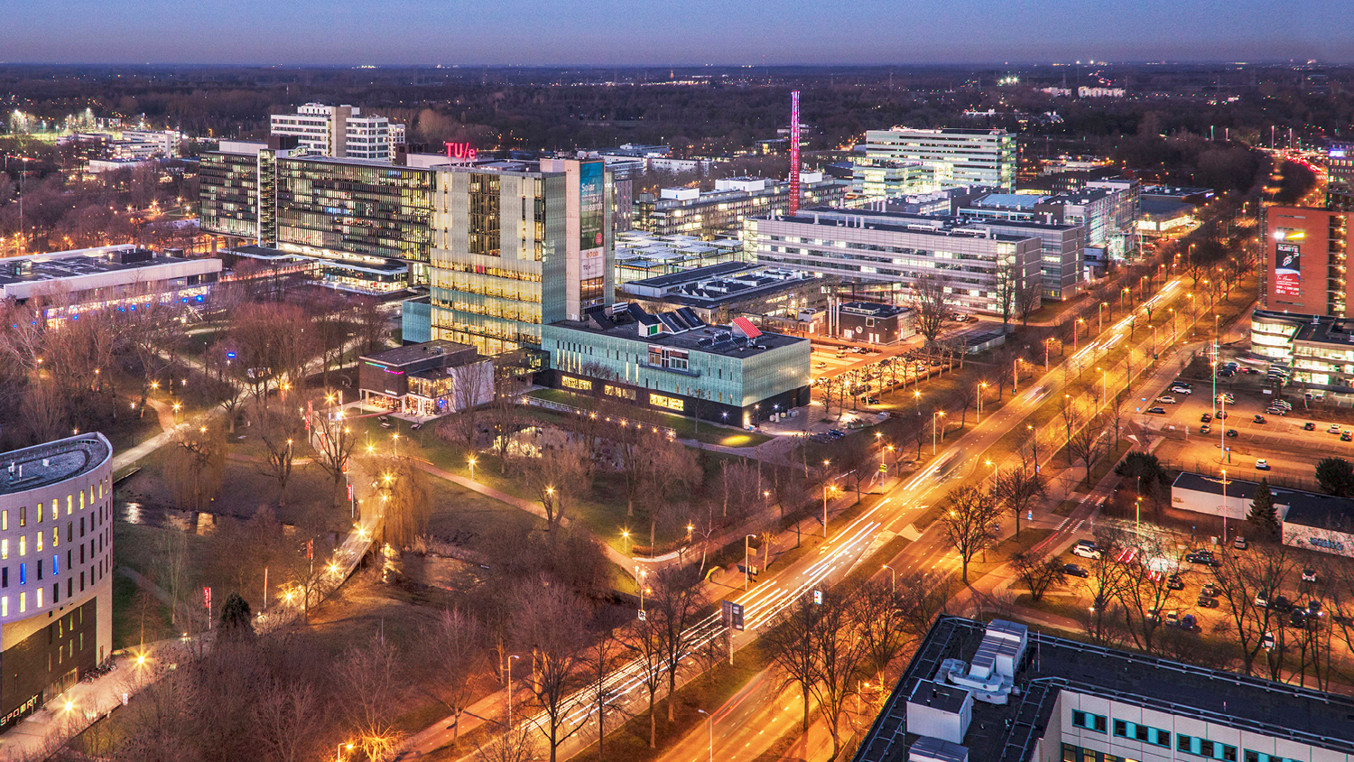
Investigating frameworks for integration and orchestration —a case study on a microbrewery digital twin
Graduation Project, 31-10-2022
Ander Lee
Department of Mathematics and Computer Science

Slide 2
Agenda
Introduction
Methodology & Design
Implementation
Evaluation
Conclusion

Slide 3
Introduction

Slide 4
Digital twin
Physical plant
Digital shadow
Digital model
monitor
Models
control/adjust
Digital twin

Slide 5
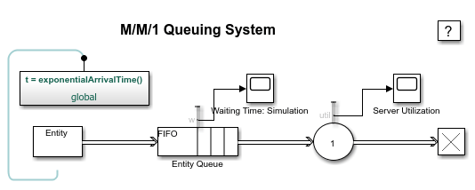


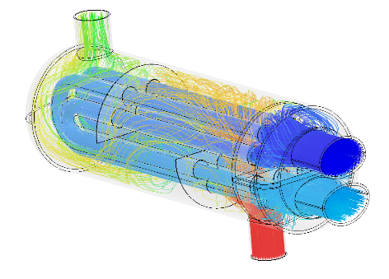

Challenge
Model of computation
More differences
Use of units
Fidelities
Communication styles
...and more
Different vendors

Slide 6
Problem description
Model A
Model A
1
Model B
2
Model C
4
Orchestration
Integration
3
interface
encapsulation
Model B
Framework

Slide 7
Research questions
What are the key ingredients for integration and orchestration of models in different services for a microbrewery DT?
How can these ingredients be generalized to benefit other application domains?
In what circumstances do the selected frameworks best fit these ingredients?

Slide 8
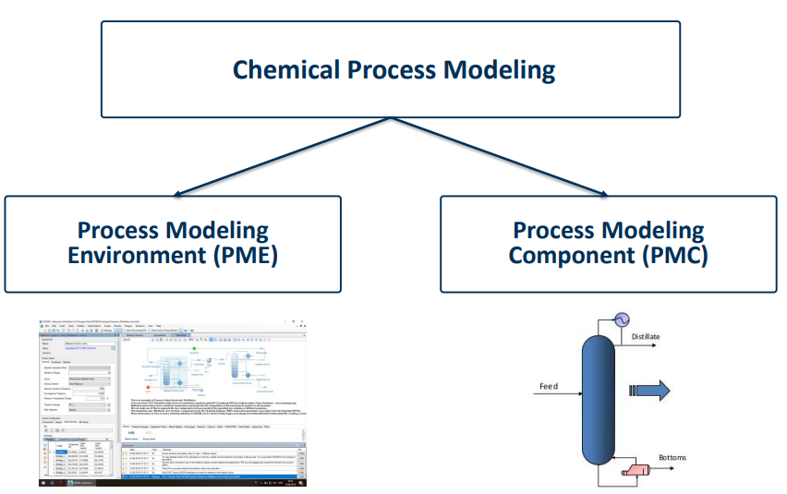
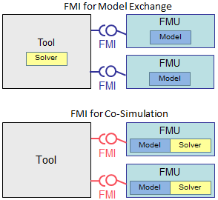
Background study
Integration approach
CAPE-OPEN
FMI

Slide 9
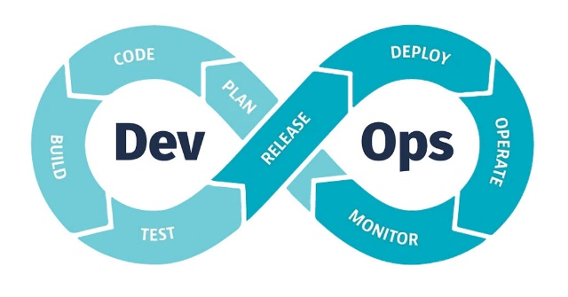
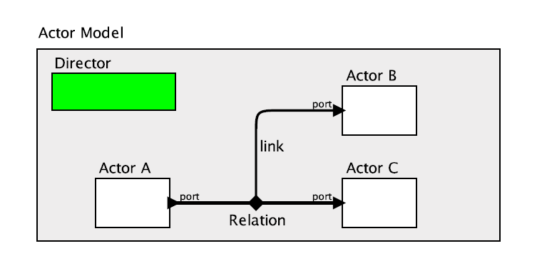
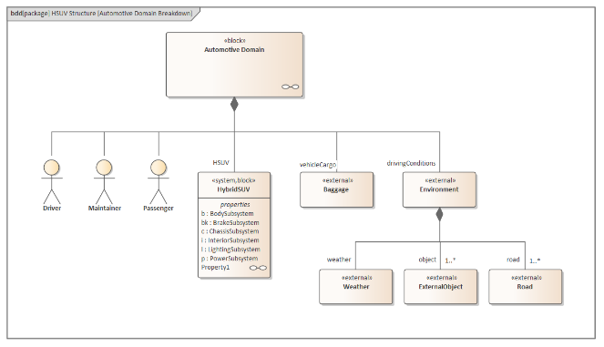
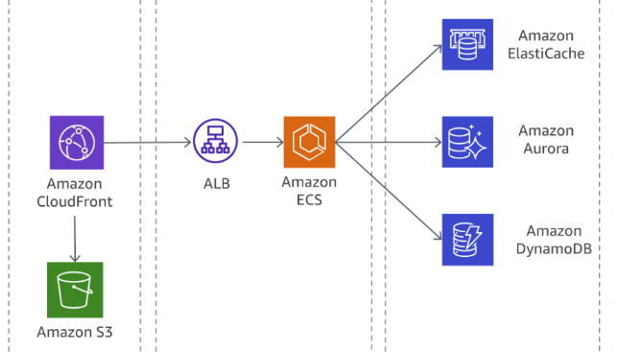
Background study
Orchestration approach
Actor orientated architecture
DevOps
Service orientated architecture
SysML/UML
platform

Slide 10
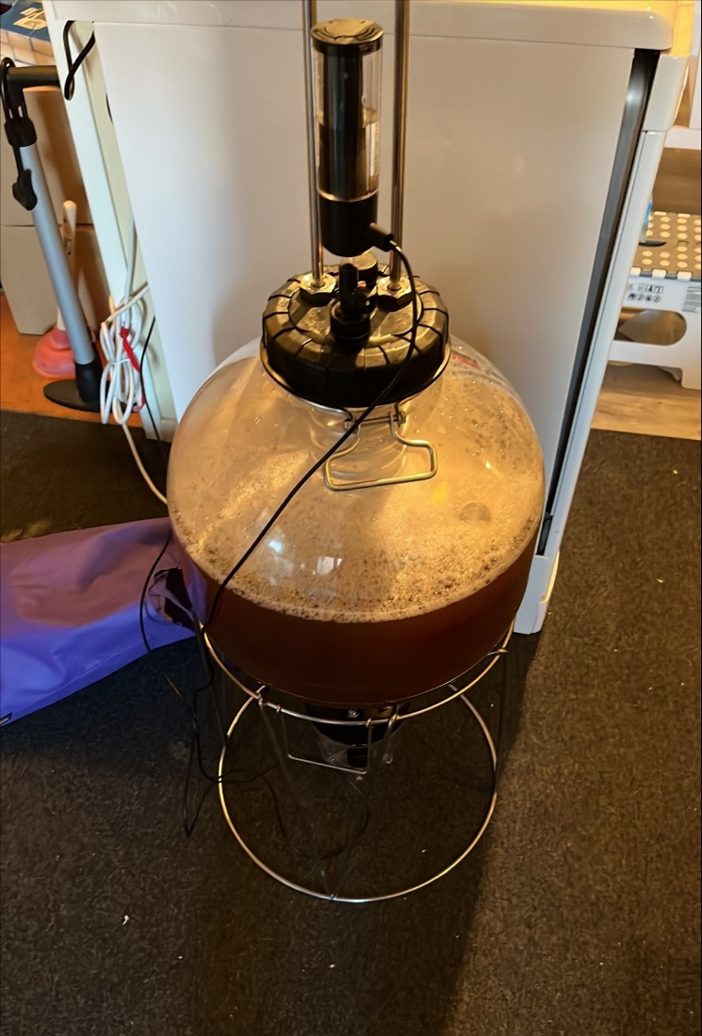
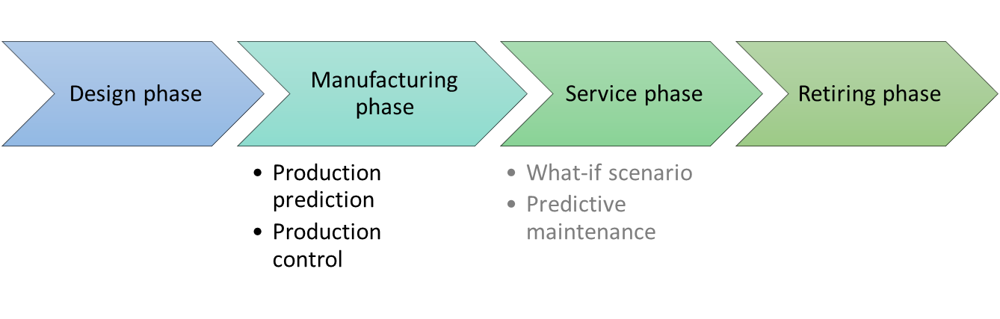
Microbrewery
Process states are easy to observe, e.g., temperature.
Conditions are relatively mild, i.e., low temperature, medium pressure.
Well studied phenomena ⇒ simple to build
Various modelling tools used for the fermentation process ⇒ I&O frameworks

Slide 11
Methodology & design

Slide 12
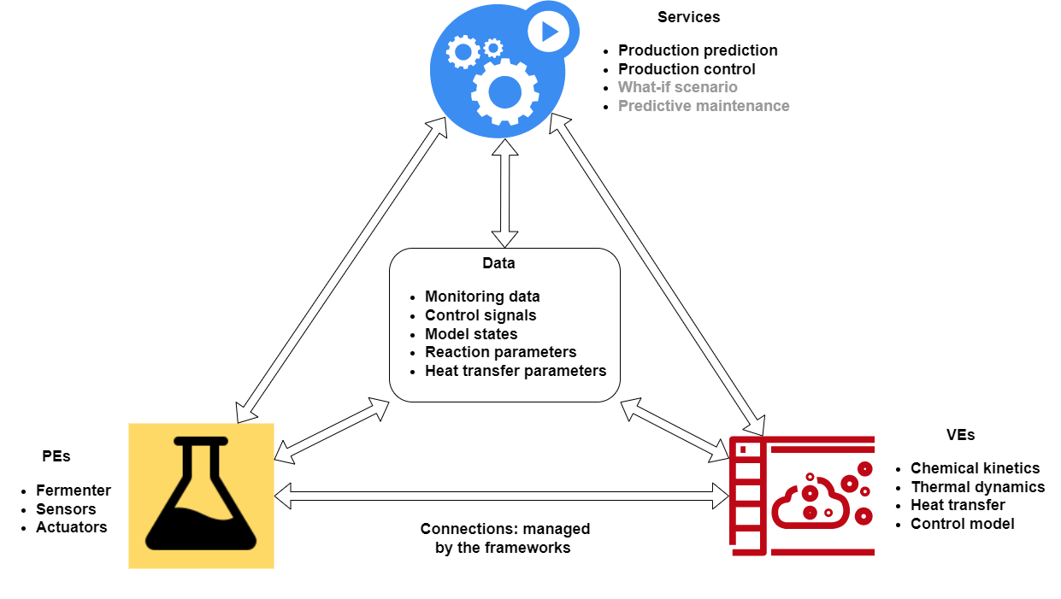
High-level architecture

Slide 13
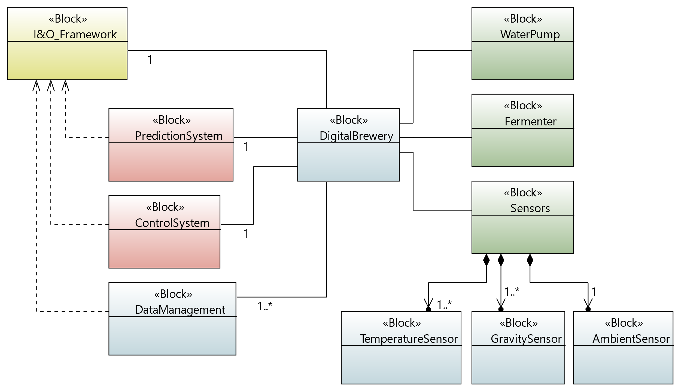
System context

Slide 14
Requirements and KPIs
S1: production prediction
Label | Requirements
R1 | The model state variables shall be validated with real-time empirical data.
R2 | The operator shall be able to configure the initial model parameters and the model execution scheme.
R3 | The model states shall update automatically based on the latest real-time data.
R4 | The model may be queried for its past states in order to optimize its present parameters.
Label | KPI
KPI1 | Level of automation
KPI2 | Updating delay
KPI3 | Data history
KPI4 | Modifiability

Slide 15
Requirements and KPIs
S2: production control
Label | Requirements
R1 | Model optimization may be triggered on the detected disturbance, time, or plant-wide performance.
R2 | Controller calibration may be triggered on time, or state variables deviation.
R3 | Service shall ensure that the calibrations comply with the controller’s desired operating range.
Label | KPI
KPI1 | Latency
KPI2 | Traceability

Slide 16
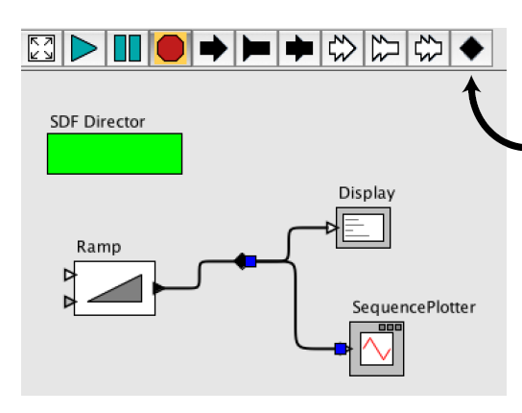

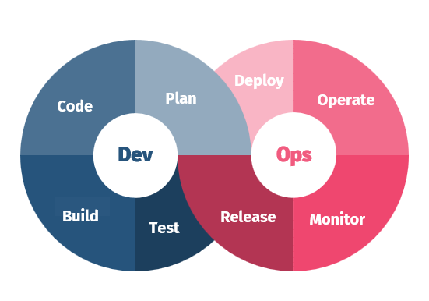

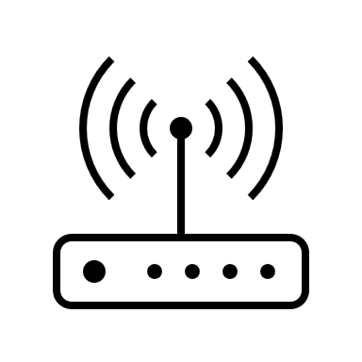



Framework overview
TwinOps
ThingsBoard
Ptolemy II

Slide 17
Implementation

Slide 18
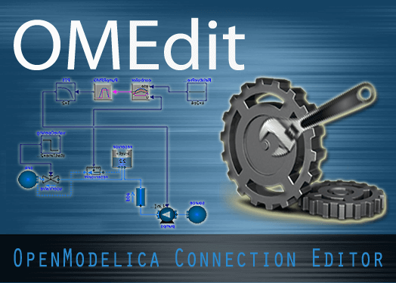
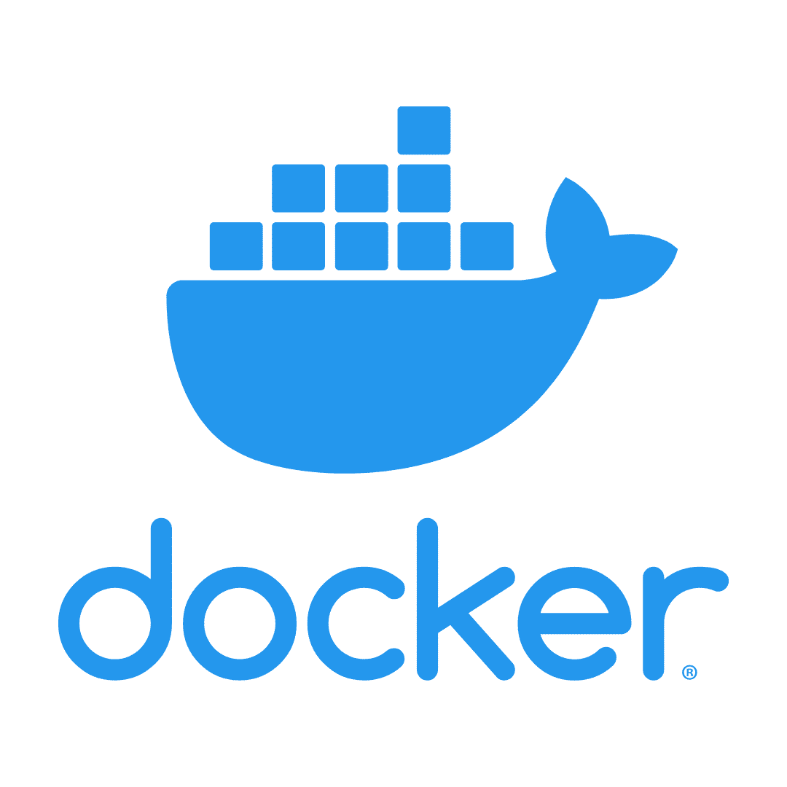
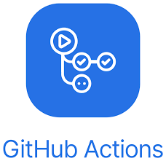



TwinOps
Model editor
CI/CD engine
Container repository
Trigger
Build
Deploy
Update
Data management
Targets

Slide 19
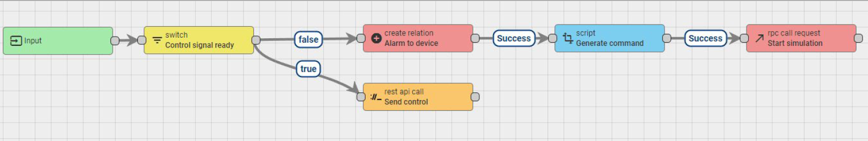
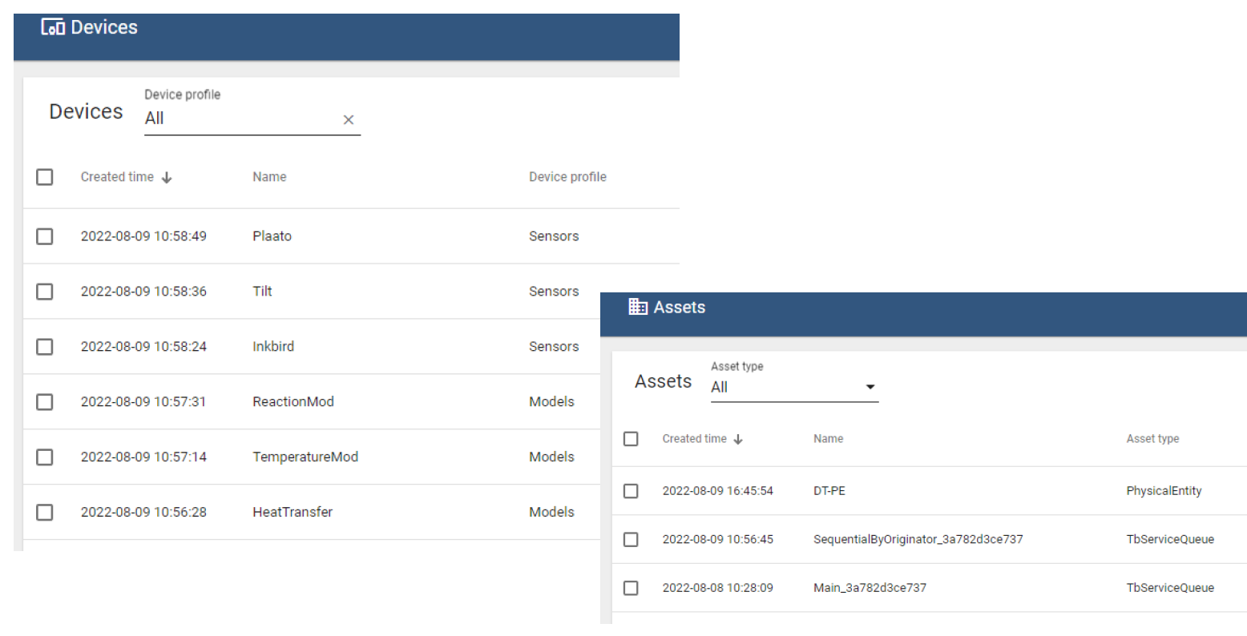
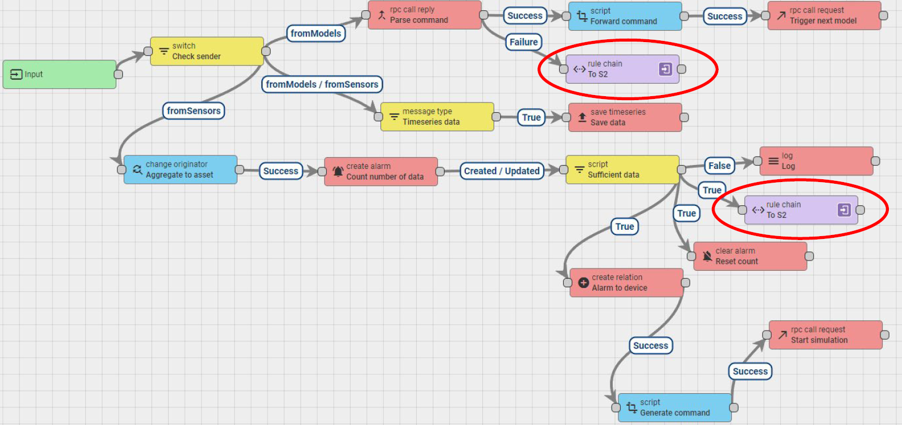
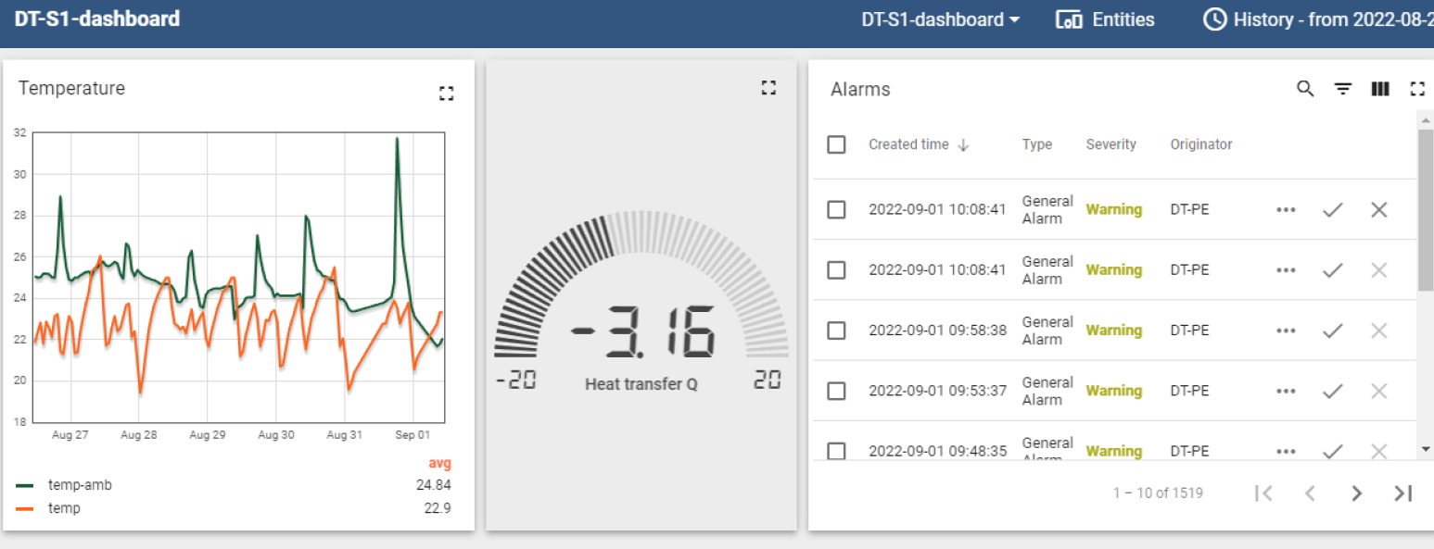
ThingsBoard
Entity provision
Rule chains
Dashboard

Slide 20
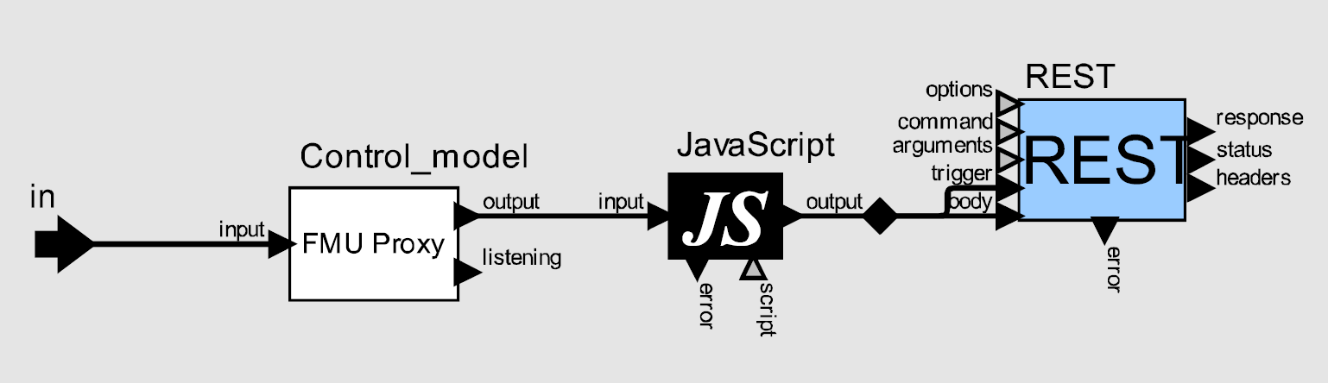
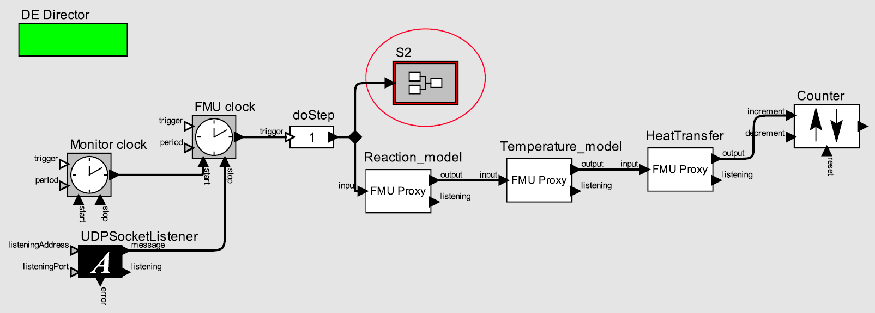
Ptolemy II

Slide 21
Evaluation

Slide 22
Limitation
methodology
TwinOps
Level of abstraction
platform
ThingsBoard
software tool
Ptolemy II

Slide 23
Comparison
 | TwinOps | ThingsBoard | Ptolemy II
Configurability | high | high | medium
Data transformation | high | medium | medium
Traceability | complex | simple | simple (inefficient)
Modularity | high | medium | low
Workflow automation | high | medium | low
Timeliness | slow | fast | fast
Managing diversity | good | good | good (needs add-ons)
I
O

Slide 24
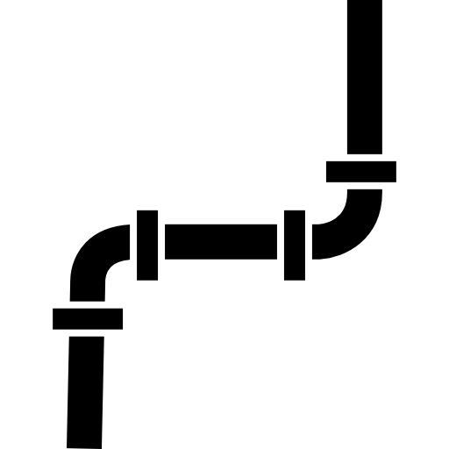


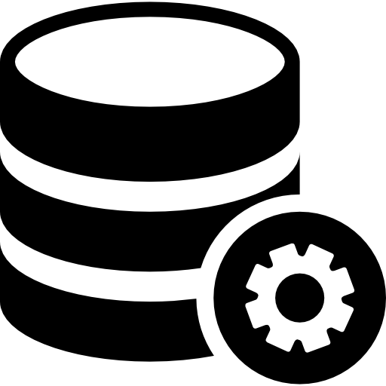
S1 KPI1
Level of automation
TwinOps
ThingsBoard
Ptolemy II
Pipeline config.
Model editor interfacing
Entity relation def.
Model editor interfacing
Data manager config.

Slide 25
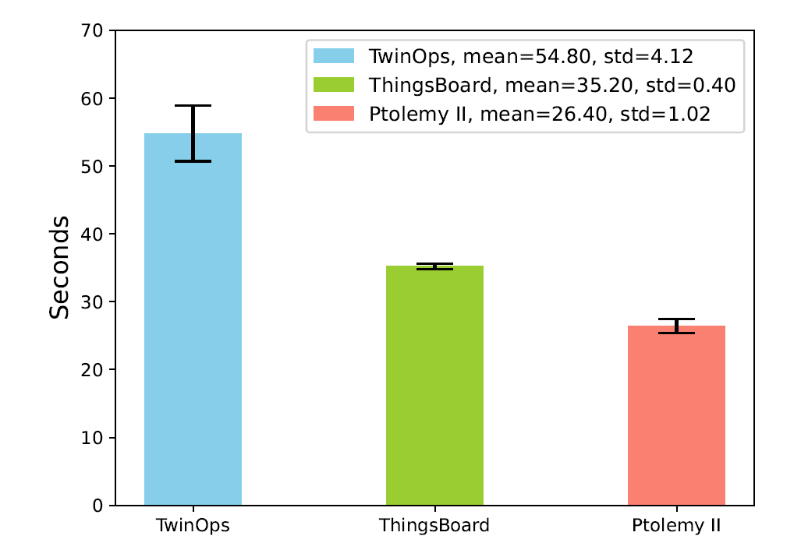
S1 KPI2
Updating delay

Slide 26
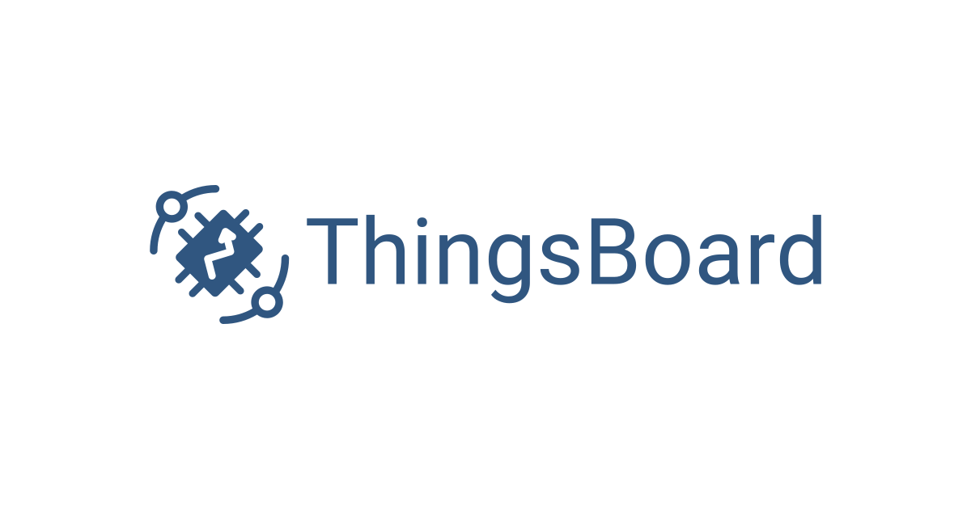

S1 KPI3
Data history
TwinOps
ThingsBoard
Ptolemy II
Model topology, CI/CD stages, …, etc.
Entity relations, rule chains, …, etc.
Directors, Actors, connections…, etc.
100%
100%
100%

Slide 27
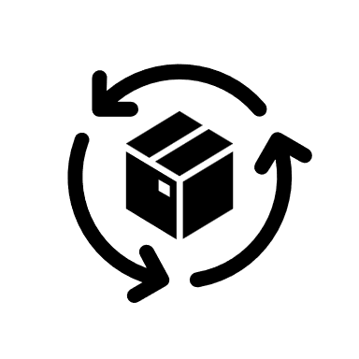
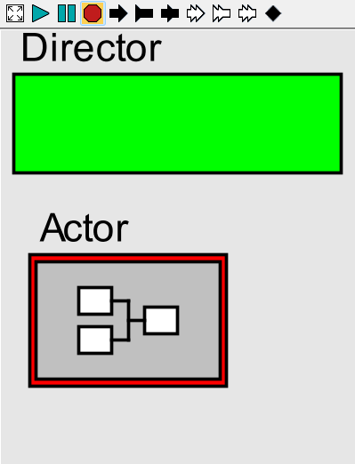


S1 KPI4
Modifiability
TwinOps
ThingsBoard
Ptolemy II
SSP
Entities
CSV
Rule chains
XML
XML
YAML
Dashboard
XML
Dockerfile

Slide 28
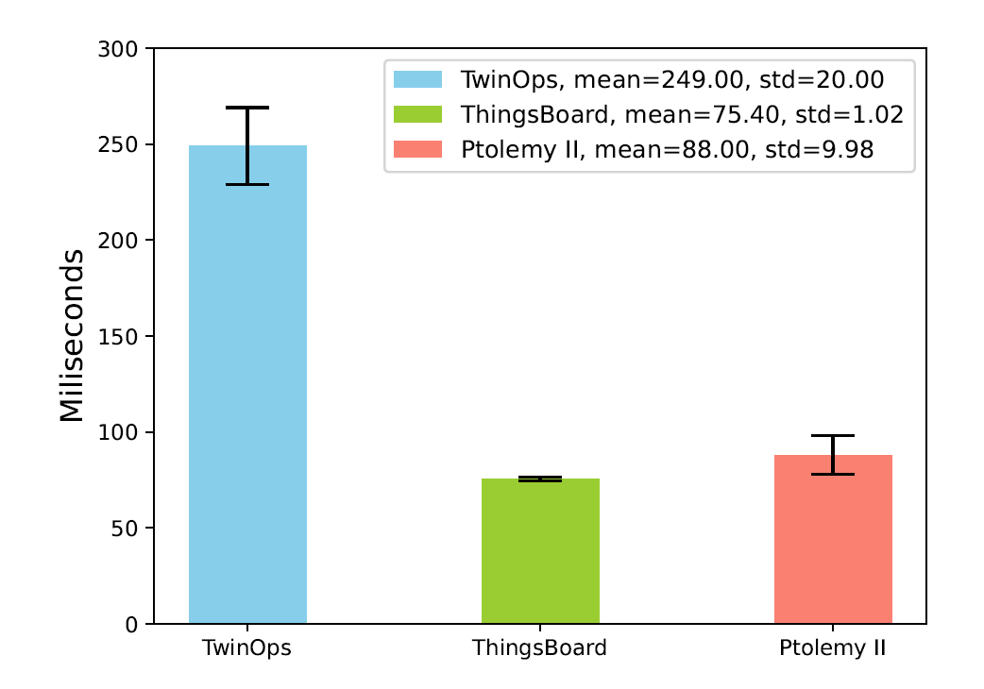
S2 KPI1
Latency

Slide 29


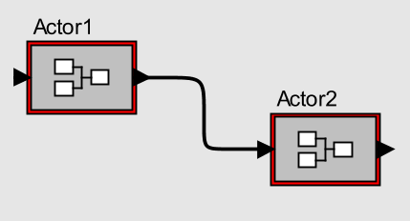
S2 KPI2
Traceability
TwinOps
ThingsBoard
Ptolemy II
Entities
Rule chains
Dashboard

Slide 30
Conclusion
What are the key ingredients for integration and orchestration of models in different services for a microbrewery DT?
Multi-stage ⇒ modularity and configurability
Monolithic ⇒ traceability
How can these ingredients be generalized to benefit other application domains?
MDSE and 5D model enable frameworks to replicate good patterns in other application domains.
In what circumstances do the selected frameworks best fit these ingredients?
Automation important? ⇒ TwinOps
Remote connectivity important? ⇒ ThingsBoard
Speed important? ⇒ Ptolemy II

Slide 31
Q & A

